Slide 1
CSE 577 Status Presentation

Slide 2
Design
4 stages design

Slide 3
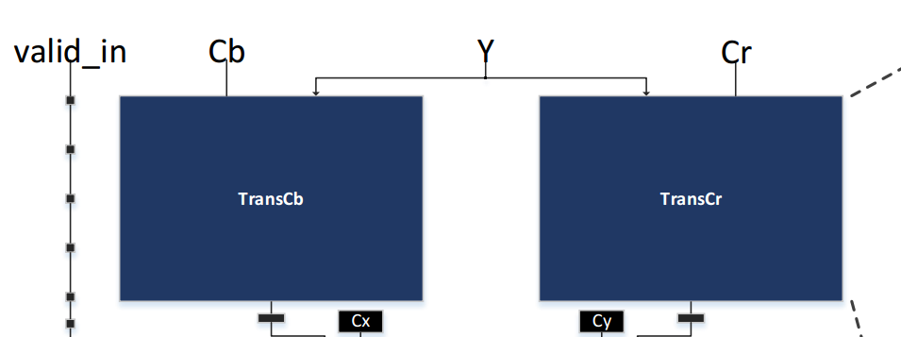
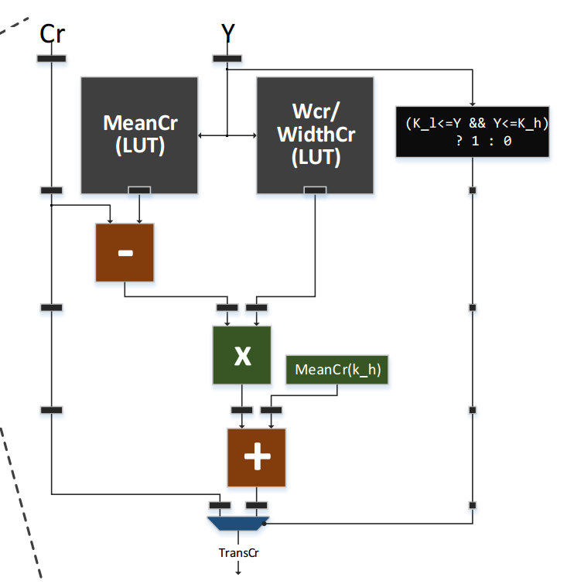
Stage 1

Slide 4
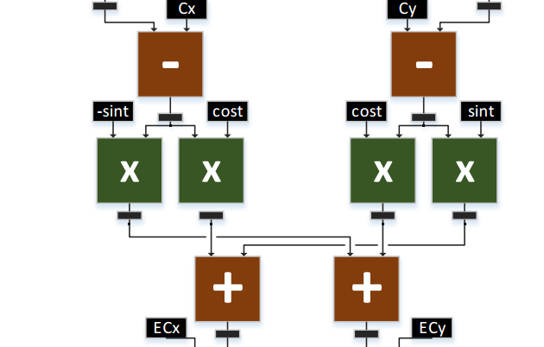
Stage 2

Slide 5
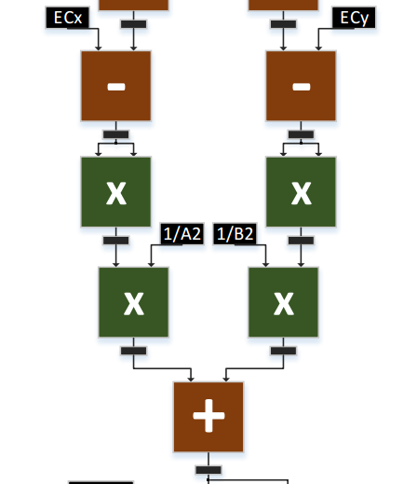
Stage 3

Slide 6
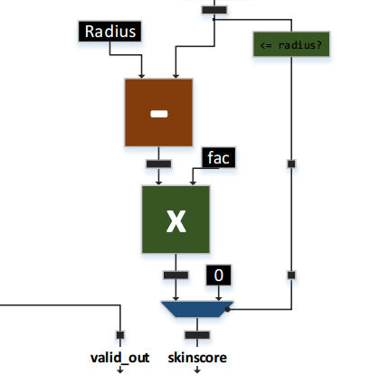
Stage 4

Slide 7
Signals Representation
cb_stage2 | 32 bit, Q.14
cr_stage2 | 32 bit, Q.14
st2_st3_1 | 32 bit, Q.14
st2_st3_2 | 32 bit, Q.14
st3_st4 | 32 bit, Q.14
skinScore | 8 bit

Slide 8
Expected Output - Output from Python code
Y | Cr | Cb | cb_stage2 | cr_stage2 | st2_st3_1 | st2_st3_2 | st3_st4 | skinScore
120 | 96 | 160 | 2615985 | 1560455 | 117702 | 235572 | 187392 | 0
76 | 130 | 182 | 1926437 | 3247257 | -867421 | -1297498 | 9696059 | 0
76 | 130 | 201 | 1926437 | 3651229 | -1198167 | -1529448 | 14312298 | 0
76 | 132 | 182 | 1968317 | 3247257 | -891467 | -1263210 | 9407008 | 0
76 | 132 | 191 | 1968317 | 3438612 | -1048137 | -1373080 | 11455070 | 0
1 | 1 | 1 | -3469743 | -2854424 | 7226573 | -2212122 | 146685945 | 0
20 | 90 | 150 | 262926 | 2812545 | 443633 | -2409873 | 26518050 | 0
38 | 160 | 115 | 2470230 | 1742335 | 52480 | 11807 | 4991 | 99
112 | 153 | 109 | 2485010 | 1766110 | 24527 | 10257 | 3723 | 139
136 | 152 | 105 | 0 | 0 | 58942 | 40935 | 2583 | 102
190 | 156 | 106 | 2541134 | 1728508 | 23089 | 77797 | 6409 | 55
Received Output - Output from design
Y | Cr | Cb | cb_stage2 | cr_stage2 | st2_st3_1 | st2_st3_2 | st3_st4 | skinScore
120 | 96 | 160 | -571331 | 3383348 | 355615 | 521951 | 79541 | 0
76 | 130 | 182 | 12073708 | -1016494 | -1601039 | -2193676 | 1752694 | 0
76 | 130 | 201 | 14890505 | -1016494 | -2177585 | -2597998 | 2619487 | 0
76 | 132 | 182 | 12073708 | -768059 | -1636699 | -2142826 | 1709306 | 0
76 | 132 | 191 | 13407980 | -768059 | -1909800 | -2334347 | 2094007 | 0
1 | 1 | 1 | -7783095 | -9204359 | 3638561 | -1019345 | 2264274 | 0
20 | 90 | 150 | 4935312 | -3716506 | 247617 | -1721677 | 850132 | 0
38 | 160 | 115 | 1657542 | 2330067 | 50593 | -13567 | 853 | 57
112 | 153 | 109 | 1734668 | 2195127 | 54176 | -52257 | 2403 | 45
136 | 152 | 105 | 1720320 | 2473984 | 17086 | 6879 | 300 | 61
190 | 156 | 106 | 1316775 | 2686699 | 69151 | 108343 | 1564 | 51

Slide 9
Synthesis

Slide 10
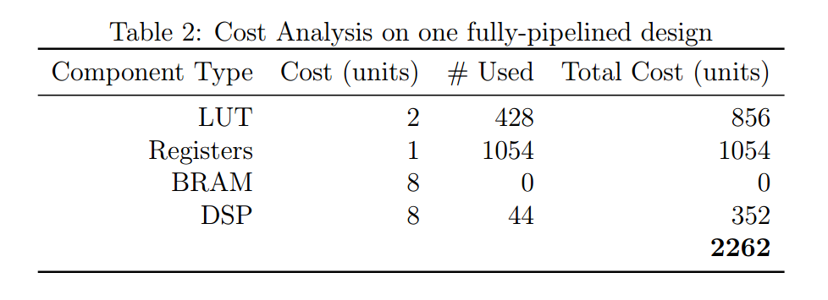
Cost

Slide 11
Performance
The design was synthesized using the 600 MHz clock
Slack (MET) for max delay paths = 0.190 ns
At 600 MHz per second, the design will have a throughput of 289.35185 FPS.

Slide 12
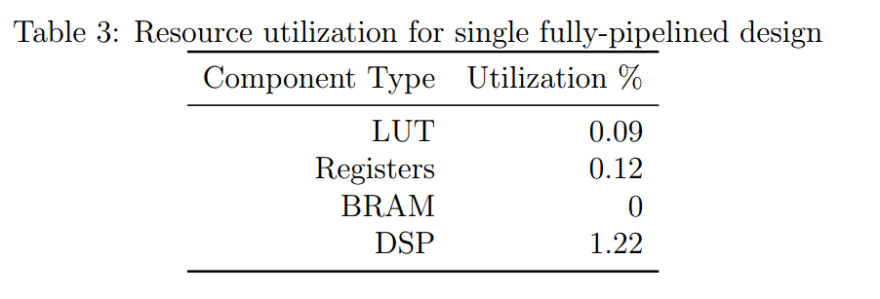
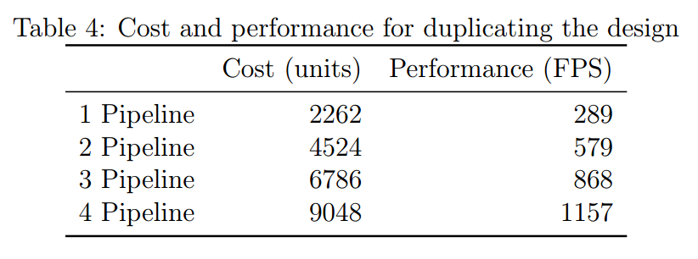
Optimizaton

